Slide 1
Costing for Family Planning: Real World Applications of Costing for Family Planning

Slide 2
Real World Applications of Costing for Family Planning
Notes:
Now that the basics of costing and economic evaluations have been discussed, a few examples of costing for family planning in the “real world” will be covered. This next section will cover costed implementation plans (CIPs), and how economic evaluations can assist with CIPs and FP program planning.

Slide 3
CIPs and strategic planning

Slide 4
What is a CIP?
Notes:
Costed Implementation Plans (CIPs) help government translate family planning goals into concrete programs and policies.
Cost data help to do this initially by assisting with the prioritization of interventions, and then utilizing cost data to predict future costs and inform allocation decisions. Using forecasted costs of activities can help technical teams to prioritize interventions.
To access available CIPs: https://www.familyplanning2020.org/cip

Slide 5
What is included in a CIP?
Notes:
Recommended focus areas are activities that can be included in a CIP.
Service delivery and access are site-level, while the remainder of the areas listed in this slide are at the above-site level.
Note that monitoring and evaluation can be at both the site and above-site level, depending where and how they are implemented.

Slide 6
Notes:
Note that activities are spread across the focus areas. However, these activities, focus areas, and priorities must be defined before the CIP is costed.
When these activities are ready to be costed, ICERs can help determine the incremental cost and incremental impact of additional FP activities.
Recently, the CIP process has been reviewed to understand ways in which a CIP can better reflect FP priorities within a country. The guidance for gathering data and creating these CIPs is currently being reviewed and edited to make the necessary adjustments to the CIP process.
The next round of CIPs is expected to see a greater focus on country-specific priorities and utilizing cost and impact data to decide on a final set of priorities

Slide 7
How can priorities be set?
Notes:
So how can priorities for these CIPs be set? Economic evaluations can help answer this question.
Another tool that can be used is called FP Goals, which can model different investment scenarios to help program planners compare plans and focus areas.
FP Goals utilizes demographic data and evidence on effectiveness of different FP interventions to help countries look at different program scenarios and prioritize interventions and investments for the FP programs.

Slide 8
How does FP Goals work?
Notes:
Establishing a Baseline: Data is collected from a range of sources (surveys, program reports, HMIS/LMIS Systems, and key informant interviews).
This data is used to understand what Family Planning efforts and programs are currently underway.
Defining Scale Up: Based on strategies and plans and discussions with stakeholders, a scenario is developed in which scale-up and implementation of new programs are defined.
Projecting mCPR Growth: Based on the scale of those interventions defined in strategies and plans, coverage of those interventions is estimated.
Based on global evidence on the effectiveness of various types of FP interventions, the impact of the coverage on mCPR growth is projected.
This process of defining scale-up and projecting mCPR growth is repeated to provide multiple scenarios, with varying levels of scale-up of existing programs and various options for implementation of new programs.

Slide 9
What interventions and results are included?
Notes:
FP Goals uses evidence from more than 70 studies. Estimates have been made around the potential effectiveness of a range of interventions on increasing mCPR.
Cost data can be input by users.
Shown above is an illustrative example of an FP Goals result. The model depicts the mCPR growth estimated in each scenario, as well as the relative contribution of each intervention. Results can be used to assess a realistic mCPR goal, and support discussions on prioritization of interventions.

Slide 10
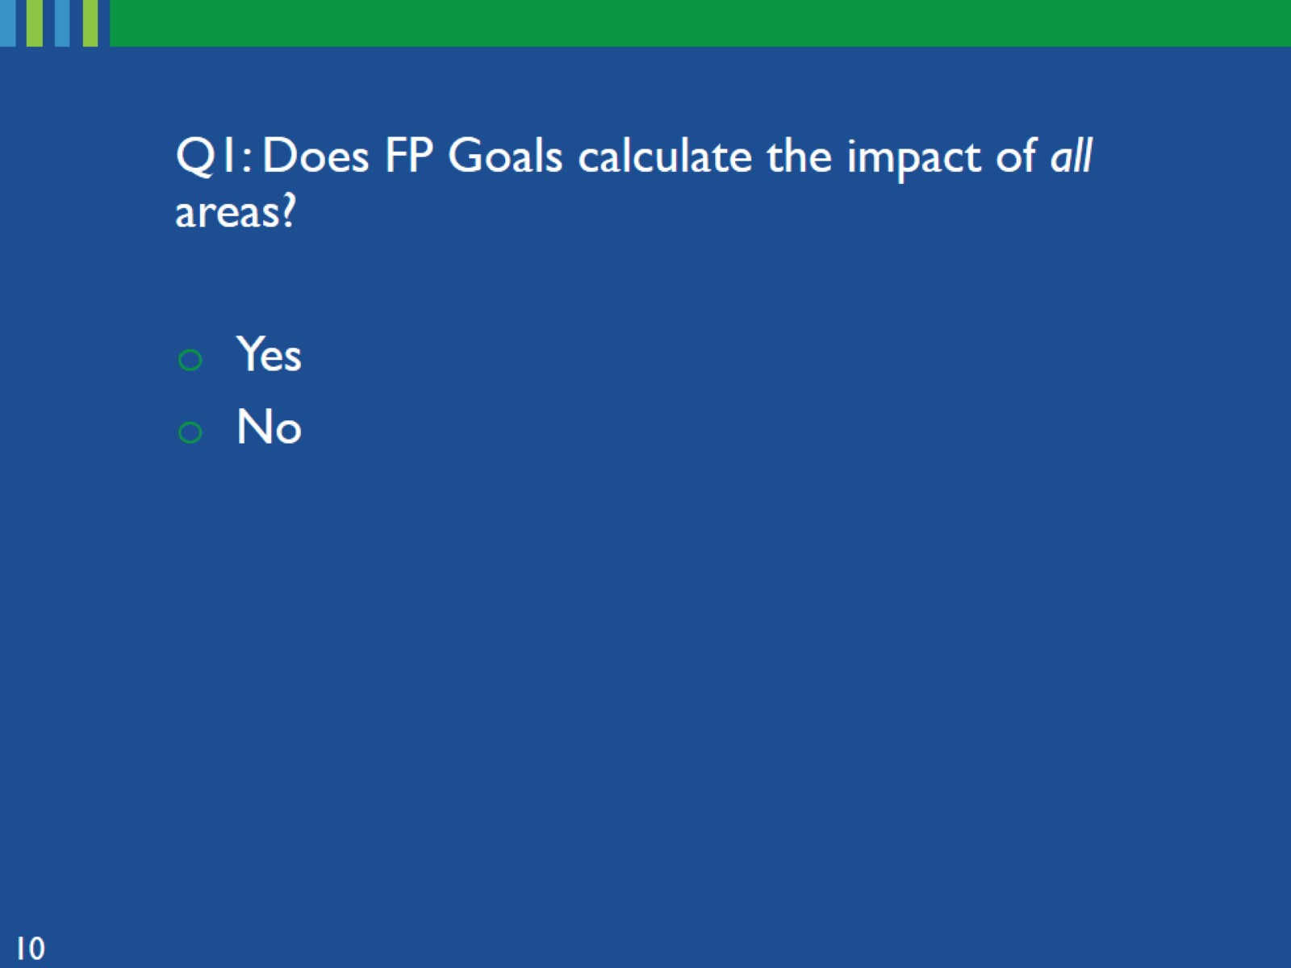
Notes:
Meaning all focus areas within a CIP, as it is currently designed.

Slide 11
Notes:
Many above-site level interventions are not included in FP Goals

Slide 13
Notes:
Excluded because there is not good effectiveness evidence for these areas

Slide 16
Circling back to CIPs
Notes:
As a reminder, CIPs are a priority setting exercise, taking information from different resources, utilizing both impact and cost data.
Additional costing can be done after priority-setting if more data is needed. Various costing resources could be used to gather this data. These will all be discussed in additional slides and modules in this training.
Resources could include:
Family Planning Spending Assessments (FPSAs)
National Health Accounts (NHA) financial data
Unit Cost Database (UCD)
Unit Cost Study Repository (UCSR)

Slide 17
The devil is in the details

Slide 18
What have we learned about using costs?
Notes:
The next section will discuss how we can adapt unit costs from one setting to inform policy decisions in another setting.

Slide 20
Notes:
No, because we don’t have enough information; currency, time period, location, etc.

Slide 21
What other information do we need to know from the study?
Notes:
This is the type of information that would be useful to know if utilizing cost data from another study.
Ideally, we would want to know all of this, but at a minimum the “characteristics” are necessary for determining comparability of a costing result
.

Slide 23
Notes:
We only know that the result is “3” per pill. Though we now know more information, there are still key characteristics that are missing.

Slide 25
Notes:
The difference in the cost of living between these two countries is significant enough that the South African cost would have to be adjusted before it could be used in Kenya. It could not directly be used without utilizing an adjustment factor

Slide 26
Notes:
The taller bar on the left is for a hospital, the bar on the right is for a health center.
Costs are divided into HR, space and equipment, medicines, and overhead costs.

Slide 27
Notes:
All cost components are higher at the hospital except medicines

Slide 30
What solutions did the authors find by digging deeper into the differences?
Notes:
After digging into the reasons behind these differences, the authors identified several issues.
These are examples of how cost data can help identify inefficiencies in provision of care, such as stock outs, HR shortages, and difficulties in client flow.
There can also be reasons not related to efficiency that can explain difference in cost, such as heterogeneity in patients.

Slide 31
Thank you for your attention!

